Slide 1
Kosovo Demand for Justice Program:
Kosovo Legal Faculty Instructional Development

Slide 2
Certificate Program in Legal Pedagogy & Instruction

Slide 3
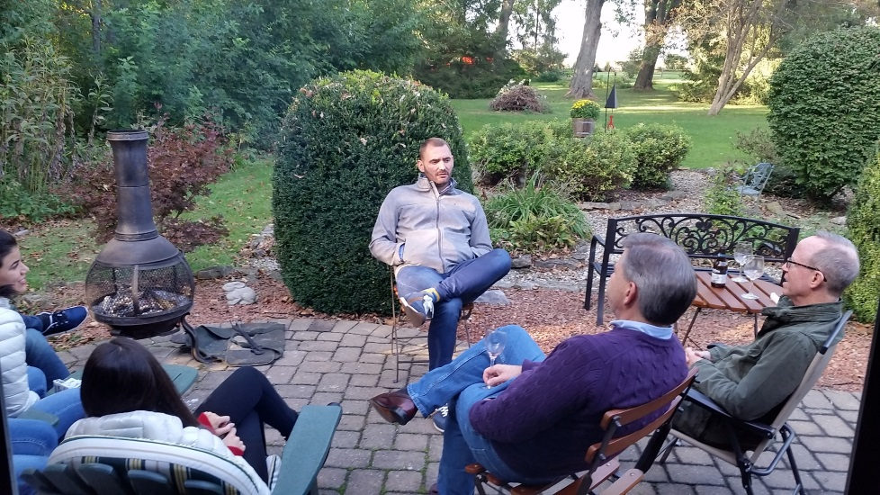
Pedagogy Program Background

Slide 4
KLFID Background
The State Department-funded KLFID Program began in 2016
Specialized instruction
Experiential learning related to legal education and pedagogy with the LL.M.
Designed to give law professors the specific skills necessary to be more effective in the classroom:
Course design,
Student assessment,
Experiential learning and
Classroom-instruction methodology.

Slide 5
Program Overview
Three required courses (6 credits)
Seminar in Legal Pedagogy & Instruction
Legal Pedagogy: Course Design & Delivery
Legal Pedagogy Practicum

Slide 6
Seminar in Legal Pedagogy
Meets one day per week – 2 hours per class session
Intensive review of concepts and theories about teaching law
Preparation and thought key to success
Course grade: pass/fail basis

Slide 7
Legal Pedagogy: Course Design & Delivery
Intensive January-term course
Students design and teach a 1.5-2 hour class on a given subject
Must select supplemental materials
Use teaching methods learned and observed during fall semester
Course grade

Slide 8
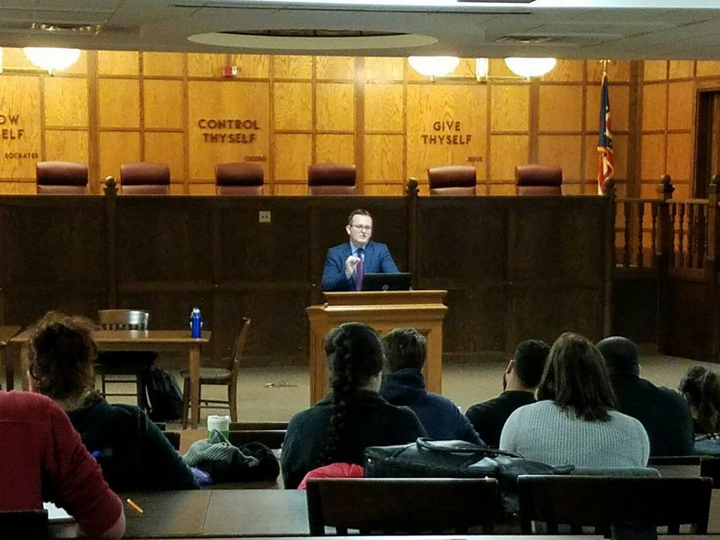
Legal Pedagogy: Practicum
Spring Semester
Assigned to ONU law professor as mentor
Work with your professor on how to participate with class preparation and delivery
Course grade

Slide 9
Program Coordinator Meetings
Meet with Pedagogy Program Coordinator in regularly scheduled meetings
Contemporaneous evaluation of program goals, participant progress
Discussion of career goals in teaching, how the program can help foster those

Slide 10
Other Activities
Legal Pedagogy Happy Hour
Three planned discussions after class
Potential site visits to other law schools
Spring semester: ONU Research Colloquium & opportunities for academic pursuits

Slide 11
Program Expectations
Collegiality
Dedication to the profession
Focus on post-program teaching

Slide 12
LLM Democratic Governance & Rule of Law

Slide 13
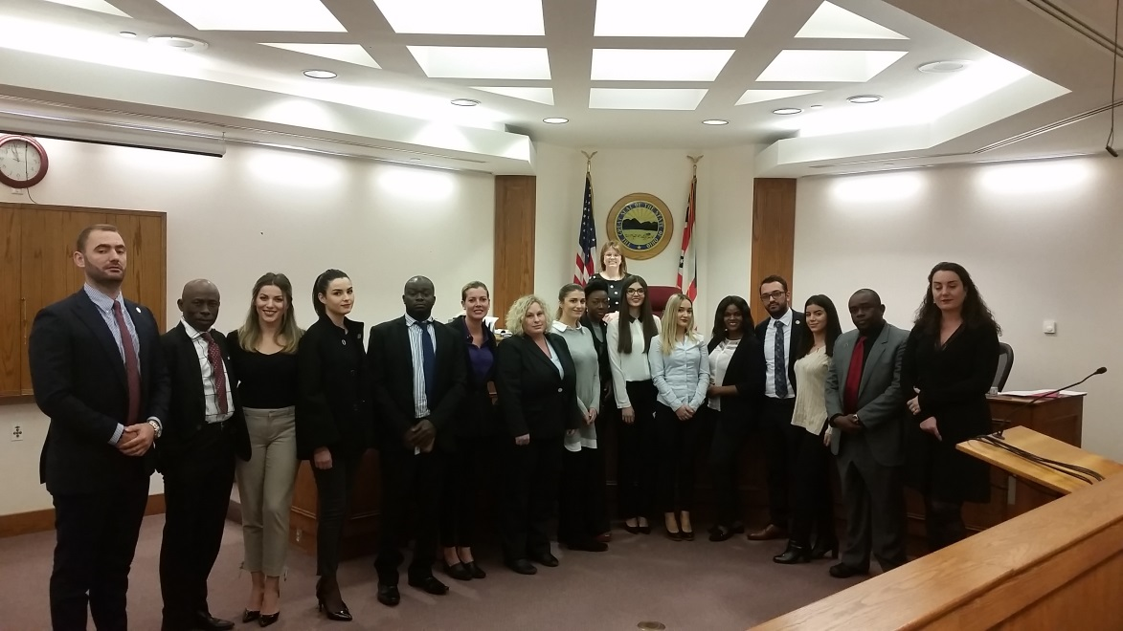
LLM Program Background

Slide 14
LLM Program Background
Began in 2007
200 students
39 countries
Designed for foreign lawyers practicing in the public sector committed to promoting governance and law reforms in their home countries.
Goal: Create leaders developing better democratic governance and rule of law principles around the world.

Slide 15
Why study in the LLM Program?
Lectures are not used as a method of instruction in the law classroom
Students are required to prepare readings or other material prior to class
Students are expected to engage in discussions and pointed questioning
By studying under leading professors in the field of democratic governance and rule of law, students are prepared to incorporate critical thinking skills into their own law school classrooms
Students are exposed to lectures and materials they could one day teach at their home university

Slide 16
LLM Requirements (24 credits)
Fall Semester:
Comparative Constitutional Law
Comparative Administrative Law
Introduction to the Rule of Law in the American Context
Public Issues in Transitional Democracies
J-Term
Select Topics
Spring Semester
Private Issues in Transitional Democracies
Competitiveness and Corruption
Rule of Law Seminar
Elective

Slide 17
Sample Fall Semester Schedule

Slide 18
Contact Information
Email: llm@onu.edu
Application Website: llm.onu.edu
Website: https://www.onu.edu/ruleoflaw/kosovo_llm_program
Facebook: Ohio Northern University LLM – Rule of Law

